Slide 1
IPBA - Batch 4 - Group 4 - Tableau
File created on: 1/8/2021 7:46:00 PM

Slide 2
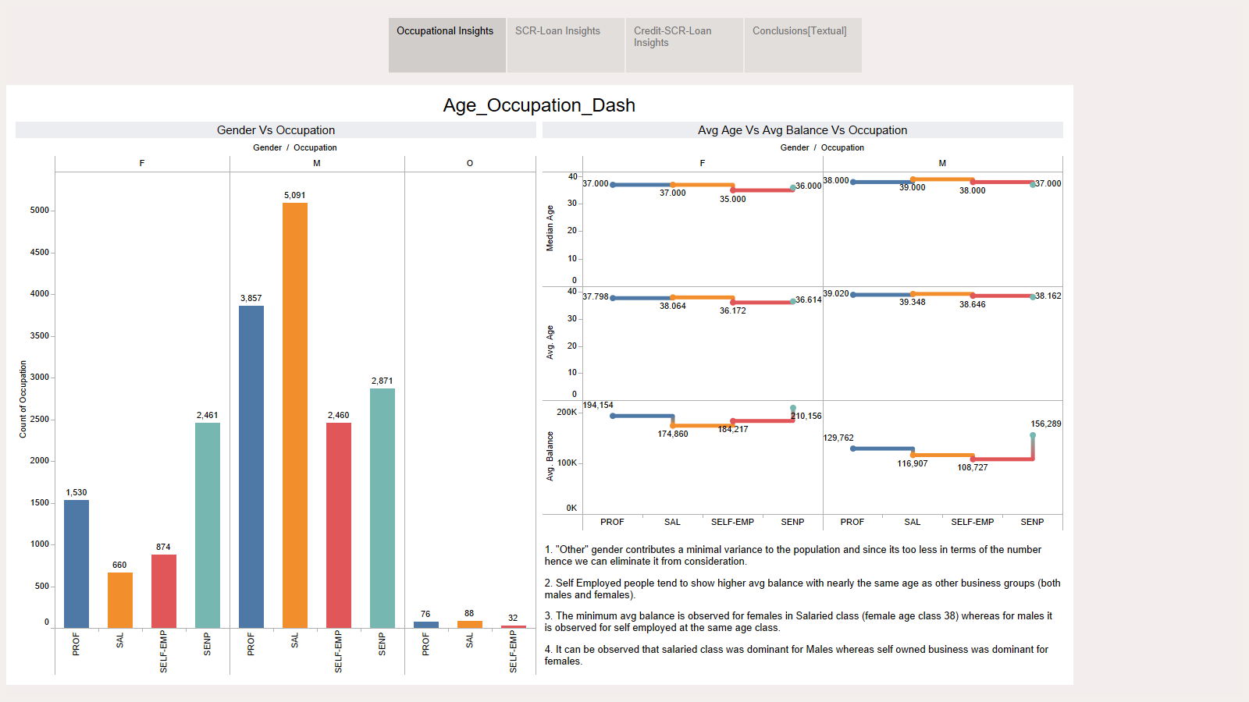

Slide 3
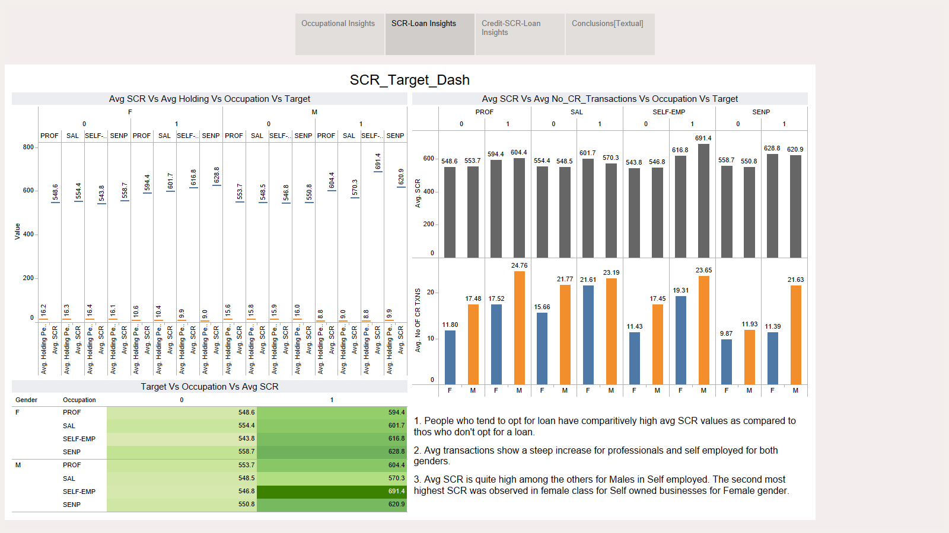

Slide 4
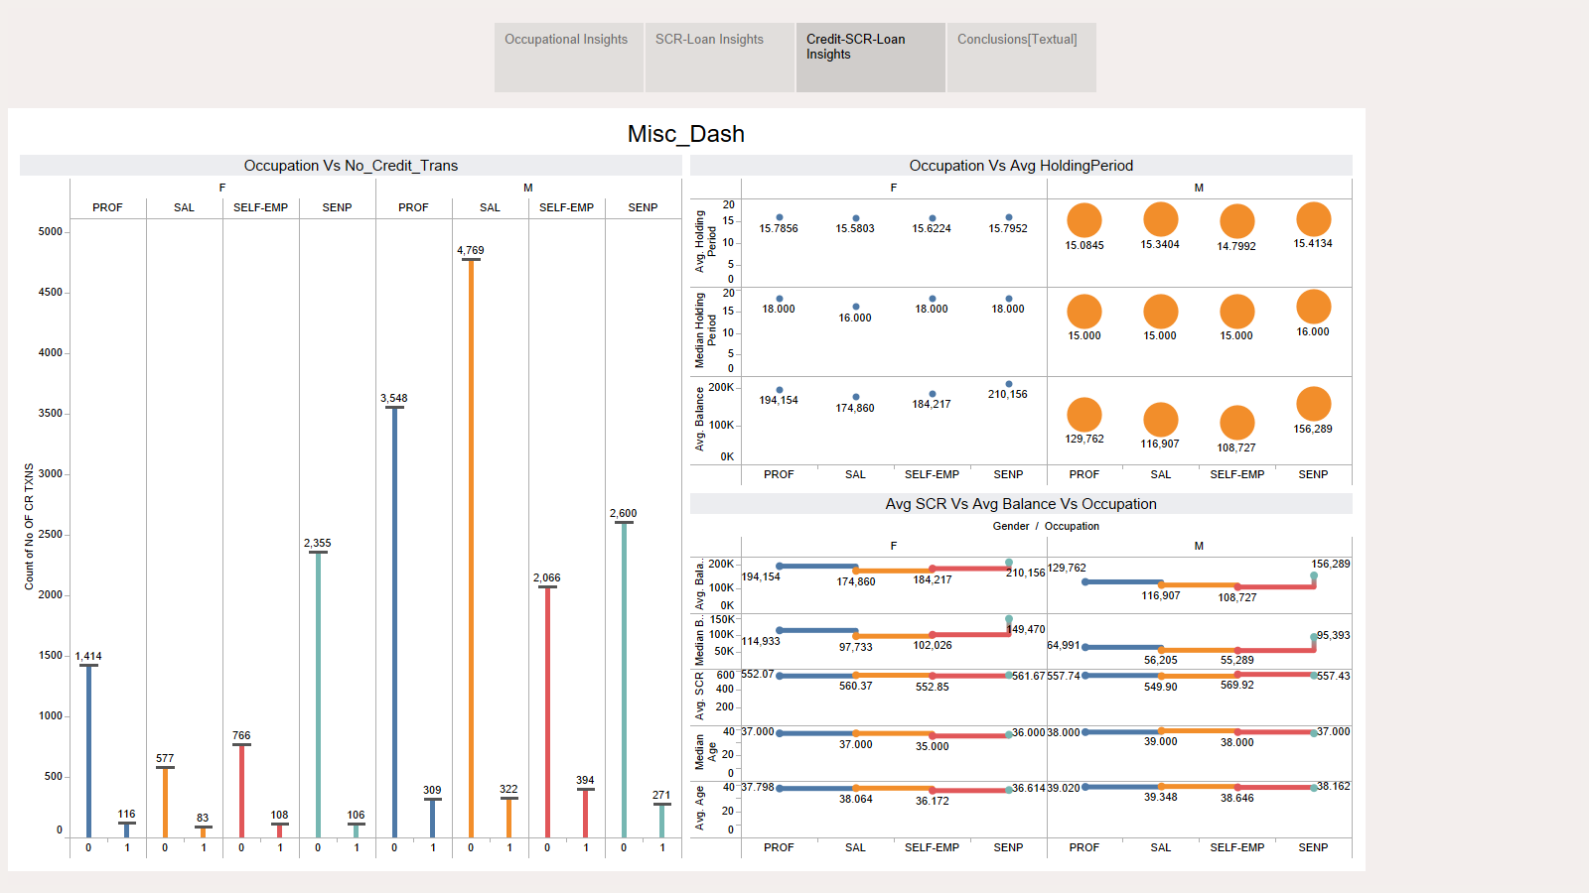

Slide 5
